Slide 1

CHAPTER 13
ENTITY AUTHENTICATION

Slide 2
Outlines
Password Authentication.
Biometric Authentication.
Multi-Factor Authentication.

Slide 3
Learning Objectives
In the end of this Chapter 13, students will be able:
To understand the concept and importance of entity authentication in cryptography and data security.
To understand the describe several approaches in the password authentication in identifying an entity.
To understand the concept of biometric authentication.
To understand the concept of multi-factor authentication in cryptography and data security.

Slide 4
ENTITY AUTHENTICATION (OVERVIEW)

Slide 5
Entity Authentication – Overview
Entity authentication is a technique designed to allow a person to identify himself, or to prove the identity of another person.
Any one can authenticate himself (claimant) via one of the following three types of witnesses:
Something that a person knows. A secret information that only known by the claimant that can be checked by the verifier. For example, password.
Something that a person has. An object that provided by the claimant to prove his identity. For example, passport, ID card, and credit card.
Something that a person is. An unique inherent characteristic of the claimant. For example, fingerprint, voice, and handwriting.

Slide 6
Entity Authentication – Overview
Differences between message authentication and entity authentication:
Message Authentication | Entity Authentication
Might not happen in real time. The sender may not presence during message authentication by the receiver. | It happens in real time. Both sender and receiver must presence during authentication. No real message communication involved until it is done.
It only authenticates one message at a time. | It authenticates the entity for the entire duration of the communication.

Slide 7
PASSWORD AUTHENTICATION

Slide 8
Password Authentication
The oldest and simplest method of entity authentication, it is ‘something’ that the claimant knows.
Each user has a user identification that is public, and a password that is private.
The password authentication can be categorized into two groups:
Fixed Password. A password that is used over and over again for every access.
One-Time Password. A password that is used only once.

Slide 9
PASSWORD AUTHENTICATION FIXED PASSWORD

Slide 10
Fixed Password – First Approach
First Approach.
The basic approach of password authentication.
The system stores the password file containing User ID and password (in plaintext form).
To access the system resources, the user sends his User ID and password to the system. The system search through the password file and if there is a match, access is granted. Otherwise, it is denied.

Slide 11
Fixed Password – First Approach

Slide 12
Fixed Password – Second Approach
Second Approach.
A more secure approach where the password is hashed.
When the password is created for the first time by a user, the system hashes it and stores both the User ID and the corresponding hashed password in the password file.
To access the system resources, the user sends his User ID and password to the system. The system hashes the password and compares the hash stored in the password file. If there is a match, access is granted. Otherwise, it is denied.

Slide 13
Fixed Password – Second Approach

Slide 14
Fixed Password – Third Approach
Third Approach.
In this approach, a salt (random string) is added into the password before hashing it.
When the password is created for the first time by a user, a salt is concatenated with the password and is then hashed.
The system stores the User ID, the salt and the corresponding hashed salted password in the password file.
To access the system resources, the user sends his User ID and password to the system. The system extract the salt, concatenate it with the password and hashes it. It then compares with the hash stored in the password file. If there is a match, access is granted. Otherwise, it is denied.

Slide 15
Fixed Password – Third Approach

Slide 16
PASSWORD AUTHENTICATION ONE-TIME PASSWORD

Slide 17
One-Time Password – First Approach
First Approach.
The user and the system agree upon a list of passwords, with each password used only once.
Advantage:
The scheme is secure from eavesdropping.
Drawbacks:
The user and the system must keep a long list of password.
If the user does not use the password in sequence, the system needs to perform a long search to find the match.

Slide 18
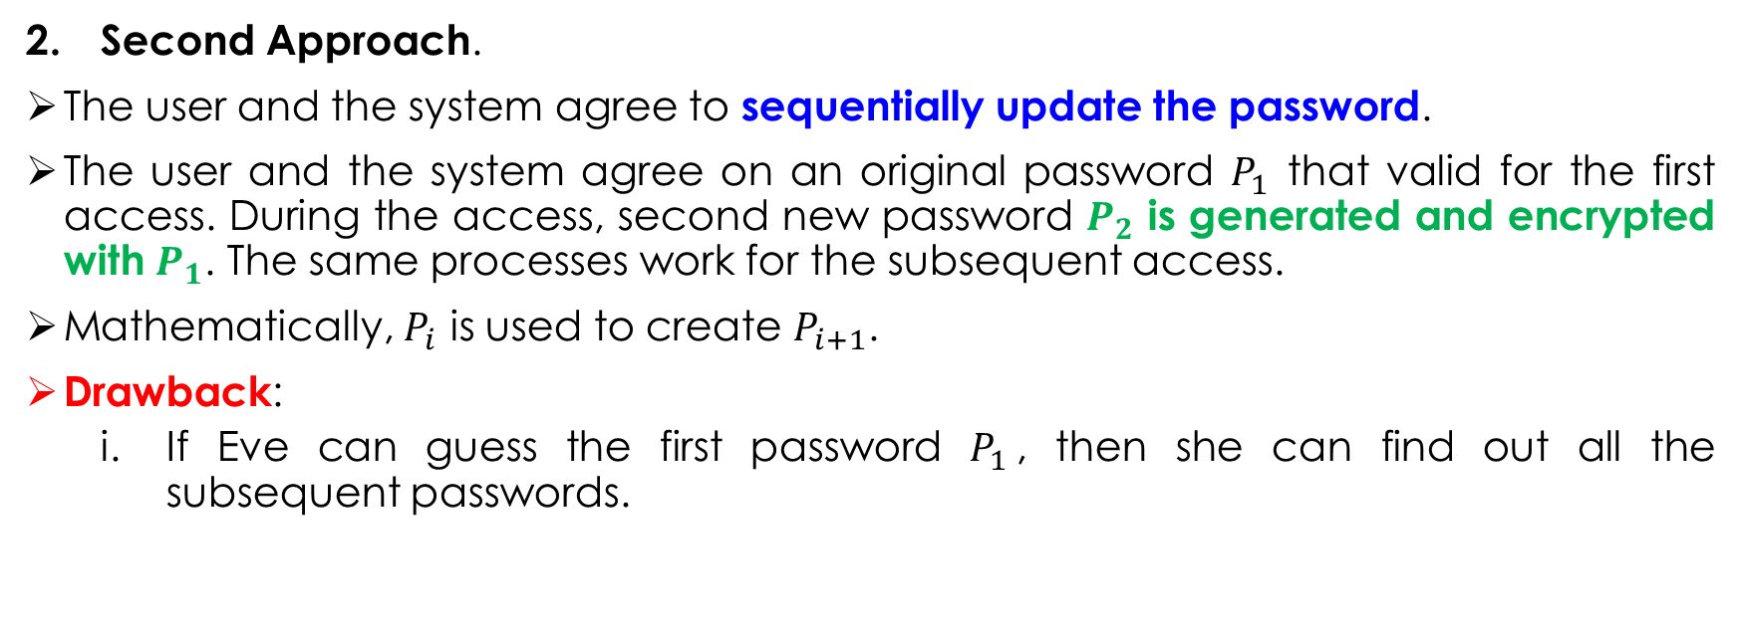
One-Time Password – Second Approach
Second Approach.
The user and the system agree to sequentially update the password.
The user and the system agree on an original password $P_{1}$ that valid for the first access. During the access, second new password $P_{2}$ is generated and encrypted with $P_{1}$. The same processes work for the subsequent access.
Mathematically, $P_{i}$ is used to create $P_{i+1}$.
Drawback:
If Eve can guess the first password $P_{1}$, then she can find out all the subsequent passwords.

Slide 19
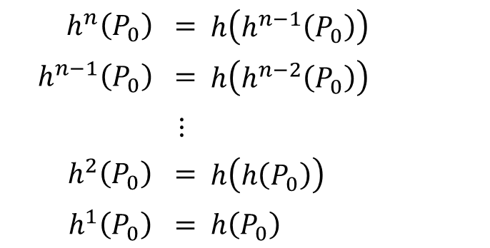
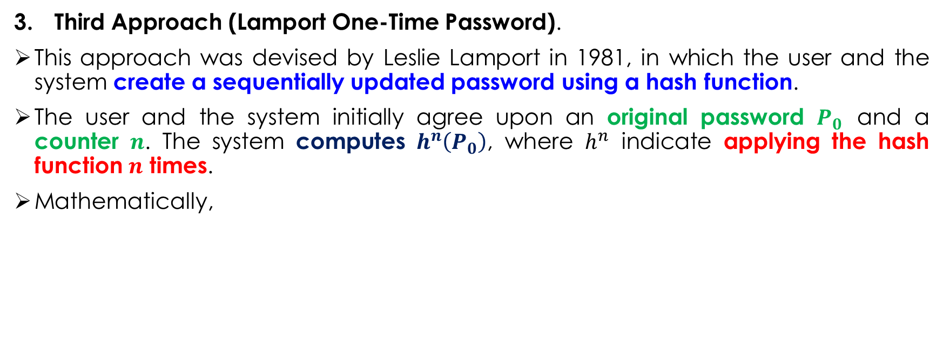
One-Time Password – Third Approach
Third Approach (Lamport One-Time Password).
This approach was devised by Leslie Lamport in 1981, in which the user and the system create a sequentially updated password using a hash function.
The user and the system initially agree upon an original password $P_{0}$ and a counter $n$. The system computes $h^{n}\left(P_{0}\right)$, where $h^{n}$ indicate applying the hash function $n$ times.
Mathematically,
$h^{n}\left(P_{0}\right)$ | $$=$$ | $h\left(h^{n−1}\left(P_{0}\right)\right)$
$h^{n−1}\left(P_{0}\right)$ | $$=$$ | $h\left(h^{n−2}\left(P_{0}\right)\right)$
 | $$⋮$$
$h^{2}\left(P_{0}\right)$ | $$=$$ | $h\left(h\left(P_{0}\right)\right)$
$h^{1}\left(P_{0}\right)$ | $$=$$ | $h\left(P_{0}\right)$

Slide 20
One-Time Password – Third Approach

Slide 21
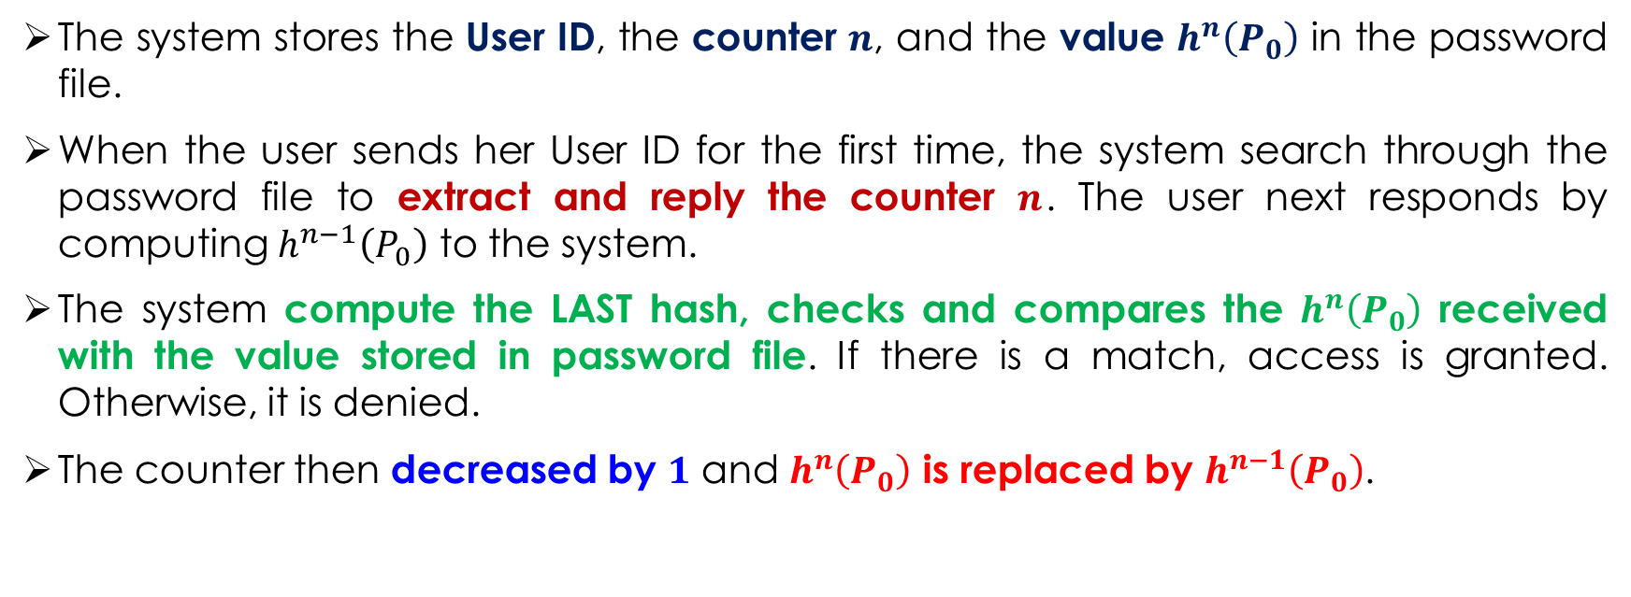
One-Time Password – Third Approach
The system stores the User ID, the counter $n$, and the value $h^{n}\left(P_{0}\right)$ in the password file.
When the user sends her User ID for the first time, the system search through the password file to extract and reply the counter $n$. The user next responds by computing $h^{n−1}\left(P_{0}\right)$ to the system.
The system compute the LAST hash, checks and compares the $h^{n}\left(P_{0}\right)$ received with the value stored in password file. If there is a match, access is granted. Otherwise, it is denied.
The counter then decreased by $1$ and $h^{n}\left(P_{0}\right)$ is replaced by $h^{n−1}\left(P_{0}\right)$.

Slide 22

One-Time Password – Third Approach
In the next access, the counter $n−1$ is replied to the user which responded with $h^{n−2}\left(P_{0}\right)$. The identical processes is repeated until the counter $n$ exhausted.
When it reaches $0$, the user can no long access the system.
To ensure the system is accessible for a longer period, the counter $n$ chosen is normally a larger number. For example, $n=1000$.

Slide 23
BIOMETRIC AUTHENTICATION

Slide 24
Biometric Authentication
The measurement of physiological and behavioural features that identify a person.

Slide 25
Biometric Authentication – Advantages
Enhanced Security. Biometric authentication provides a higher level of security. It is ‘something that a person is’ that cannot be guessed, stolen, or shared. It ensures non-repudiation property that a person cannot deny that he is someone.
Convenience. Users don’t have to remember complex passwords or carry around security tokens.
Improved User Experience. Biometric authentication is quick, easy, and doesn’t require any special skills or knowledge. This makes it an ideal choice for applications that require high levels of security, such as banking, healthcare, and government services.

Slide 26
Biometric Authentication – Disadvantages
High Cost. The hardware and software required for biometric authentication can be costly, and the systems need to be regularly updated and maintained to ensure their effectiveness.
Privacy Concerns. Biometric authentication systems store sensitive information about individuals, such as their fingerprints or facial features.
Accuracy. Biometric authentication systems may sometimes incorrectly identify individuals, leading to false positives.

Slide 27
MULTI-FACTOR AUTHENTICATION

Slide 28
Multi-Factor Authentication
This authentication technique requires two or more mechanisms to authenticate a user.
It is sometimes called the strong authentication since a user must possesses two or more information to identify/authenticate himself.
It is the combination of the following three components:
Something that you know (password).
Something that you have (smartcard/badge).
Something that you are (biometric).

Slide 29
Main References for Chapter 13
Forouzan, B.A. “Introduction to Cryptography and Network Security”, Third Edition, McGraw-Hill, 2008.

Slide 30
~ THE END ☺ ~

